Slide 1
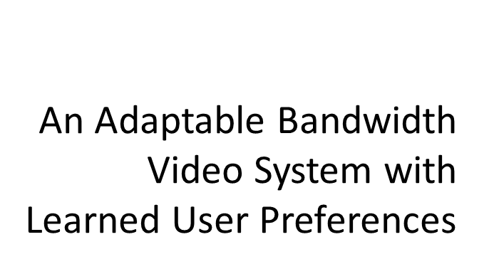
Dustin Wright
March 7, 2014
San Diego State University

Slide 2
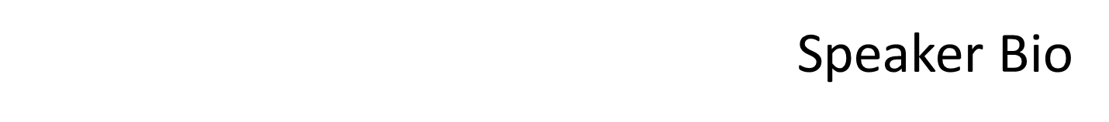
Senior, majoring in computer engineering
Expected graduation: Dec. 2014
Member of 7 honor societies
On campus involvement
  Former webmaster of Eta Kappa Nu honor society (2 semesters)
  IEEE officer (7 semesters)
    Co-social chair
    Webmaster
    Project manager
Involved in research since January 2013

Slide 3
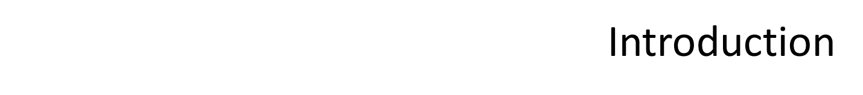




Slide 4
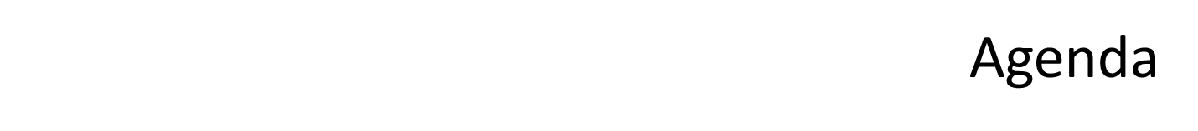
Camera System Overview
  Our Solution
  Video Scaling
  User Profiles
Experiments
Q&A

Slide 5
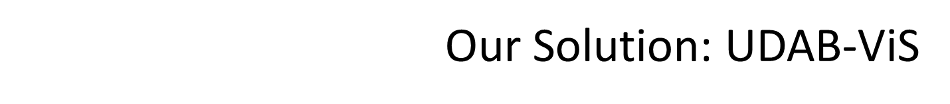
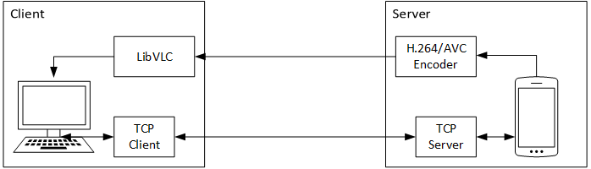
User Driven
  Let the user select how to scale the bandwidth
  Learn, based on contextual features, what decisions the user makes
  Predict the user’s choice when the video needs to be scaled
Adaptable Bandwidth Video System
  Adaptable: video bandwidth changes as channel bandwidth changes
  Can alter spatial, temporal, or quality resolution
Figure 1 – System Architecture

Slide 6
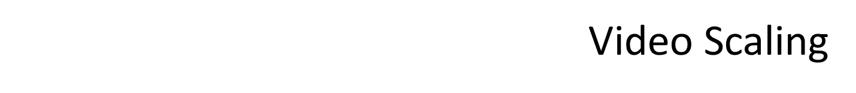
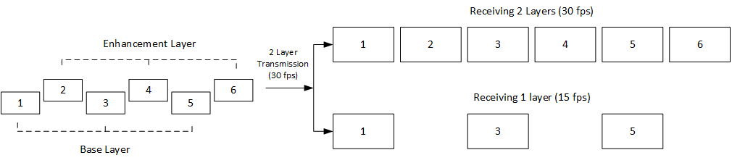
Adaptive Bitrate Streaming (ABR)
H.264/SVC
  Separate into multiple spatial streams
  Start with one base layer, multiple enhancement layers; each represents a valid stream
Our method: H.264/AVC stream-switching
Figure 2 – SVC Temporal Scaling

Slide 7
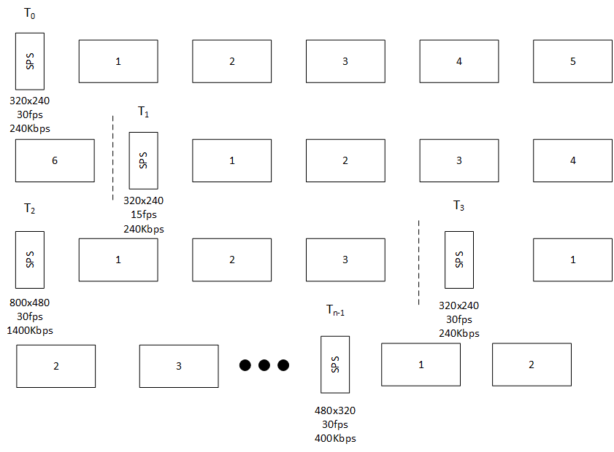
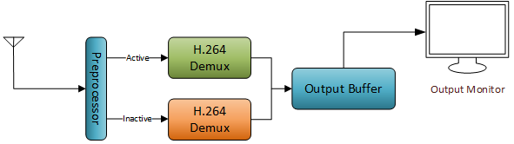
Figure 3 – Transmitted Stream
Figure 4 – Receiver Architecture

Slide 8
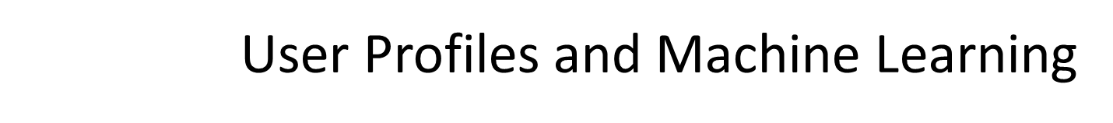
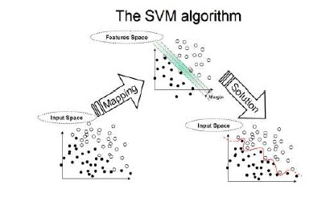
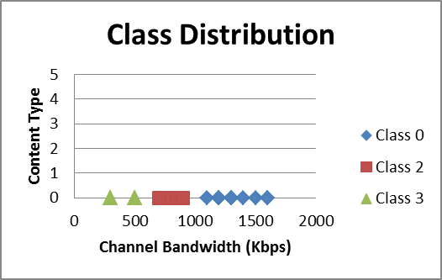
*
Classification
  4 classes based on two preferences
    High frame rate vs. low
    Size vs. quality
  Use two support vector machines
  Develop a training set as user
  makes scaling decisions
  Train the SVMs, determine user’s
  class
  Determine if bandwidth should be
  increased or decreased
Figure 5 (top) – SVM
Figure 6 (bottom) – Learning test
class distribution
*Image found at http://www.dtreg.com

Slide 9
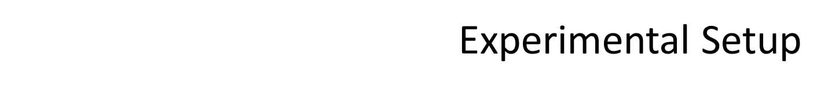
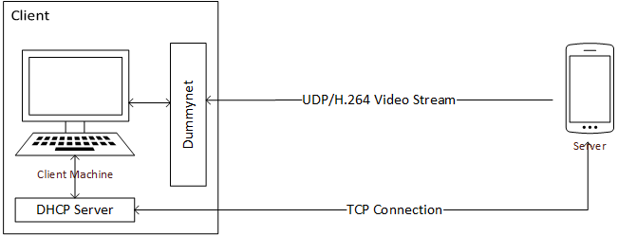
Test Cases
  Bandwidth control with quality resolution
  Bandwidth control with spatial resolution
  Intelligent decisions using user profiles
Figure 7 – Test setup

Slide 10
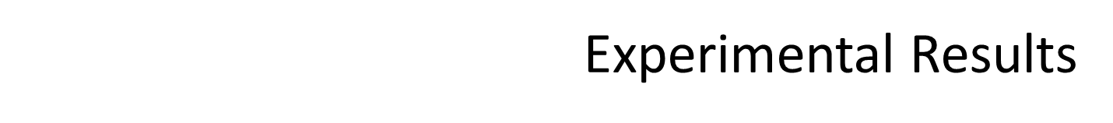
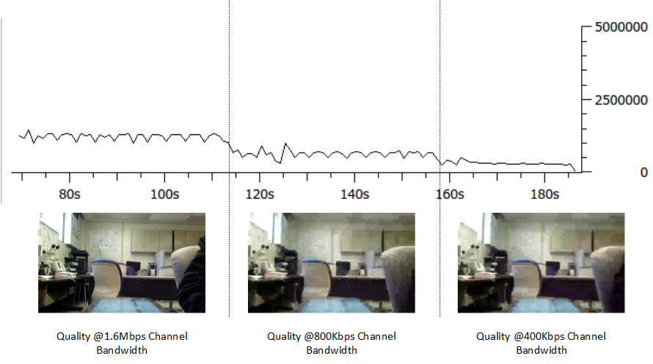
Test one: quality scaling (figure 8)

Slide 11
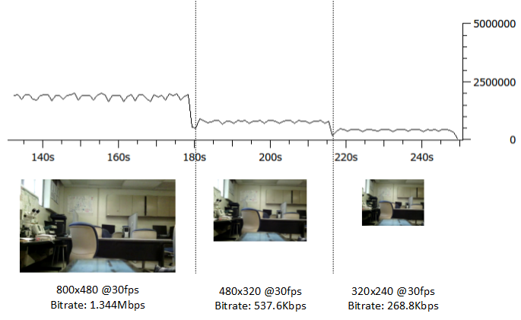
Test two: spatial scaling (figure 9)

Slide 12
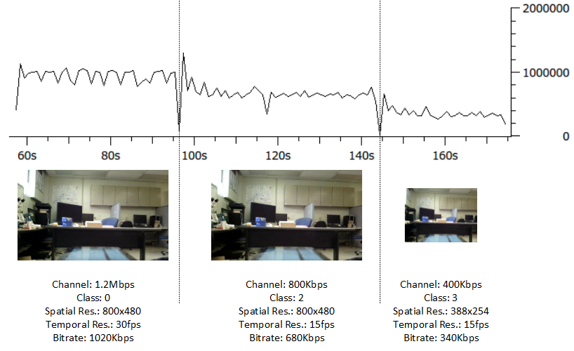
Test three: user profile (figure 10)

Slide 13


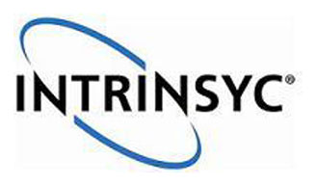

Dr. Yusuf Ozturk
Dr. Yeongjee Chung
Electrical and Computer Engineering Department

Slide 14
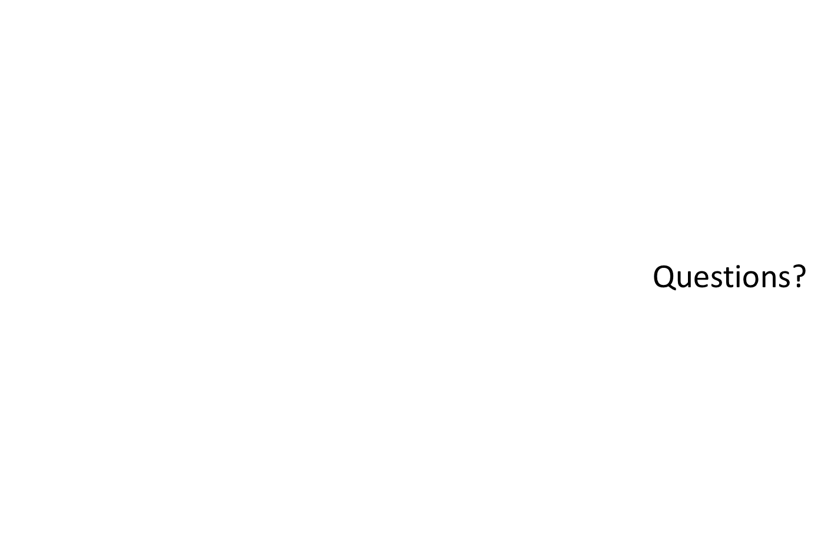

Slide 15
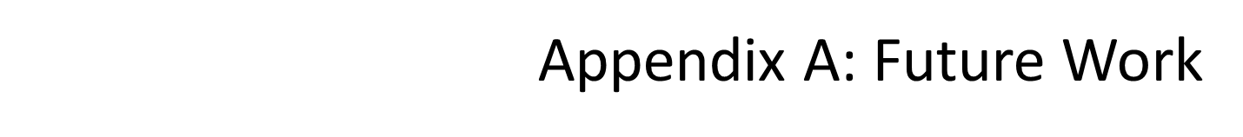
Unequal protection
  Leverage the existing system to research unequal protection of video packets
  Experiment with using different modulation and coding for different packets
Region-of-interest encoding

